Slide 1
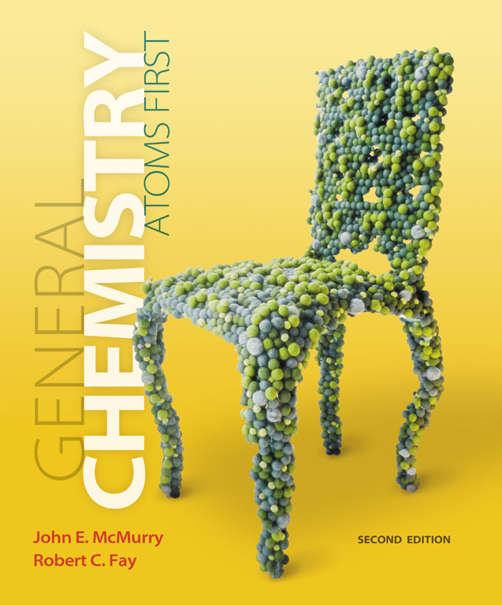
Clicker Questions
Chapter 7
Reactions in Aqueous Solution
Donald Linn
Indiana University–
Purdue University Fort Wayne
Fort Wayne, IN

Slide 2
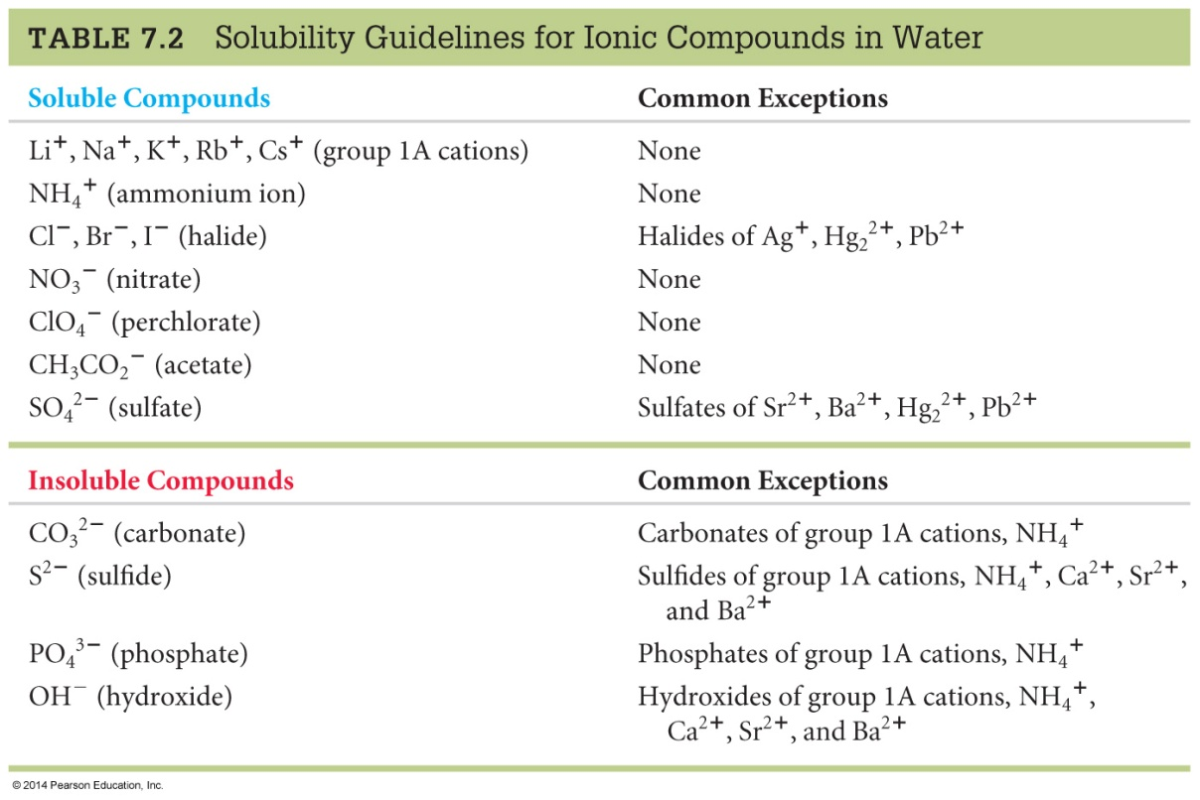
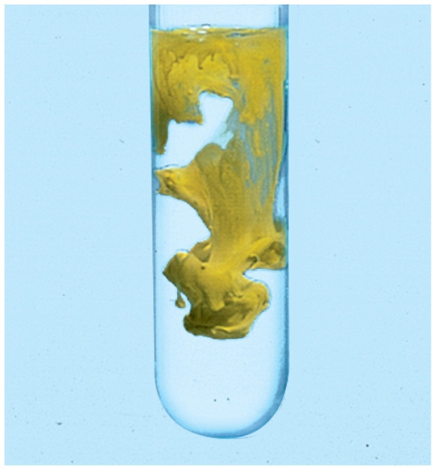
Which of the following pairs of solutions, when mixed, will form a precipitate?
a) NaCl(aq) + KNO₃(aq)
b) NH₃Br(aq) + CaSO₄(aq)
c) MgCl₂(aq) + NaOH(aq)
d) AgNO₃(aq) + LiClO₄(aq)
e) MgBr₂(aq) + AlCl₃(aq)
Notes:
Answer: c

Slide 3
Which of the following pairs of solutions, when mixed, will form a precipitate?
a) NaCl(aq) + KNO₃(aq)
b) NH₃Br(aq) + CaSO₄(aq)
c) MgCl₂(aq) + NaOH(aq)
d) AgNO₃(aq) + LiClO₄(aq)
e) MgBr₂(aq) + AlCl₃(aq)
Notes:
Answer: c

Slide 4
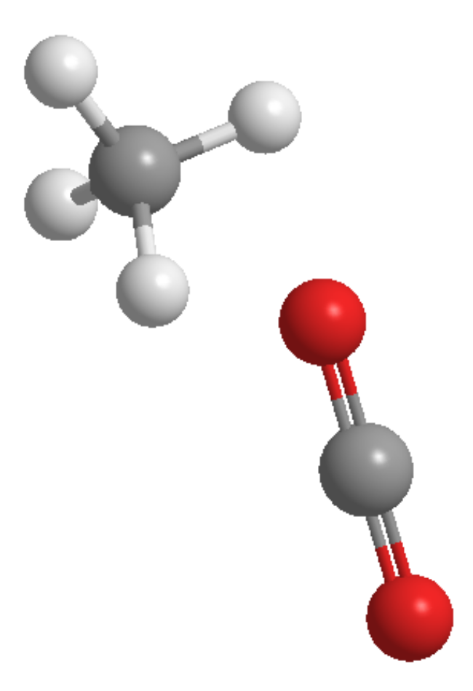
When methane is burned in oxygen, the product containing the carbon atom is carbon dioxide. The oxidation numbers of the carbon atoms in methane and carbon dioxide, respectively, are
a) +4, –4
d) –2, +4
b) +2, –2
e) –4, +4
c) –1, +2
Notes:
Answer: e

Slide 5
When methane is burned in oxygen, the product containing the carbon atom is carbon dioxide. The oxidation numbers of the carbon atoms in methane and carbon dioxide, respectively, are
a) +4, –4
d) –2, +4
b) +2, –2
e) –4, +4
c) –1, +2
Notes:
Answer: e

Slide 6
The rusting of iron is a redox reaction where iron is oxidized and changes oxidation states from 0 to 3. Which of the following reactions is not an oxidation reaction?
a)
b)
c)
d)
e)
Notes:
Answer: e

Slide 7
The rusting of iron is a redox reaction where iron is oxidized and changes oxidation states from 0 to 3. Which of the following reactions is not an oxidation reaction?
a)
b)
c)
d)
e)
Notes:
Answer: e

Slide 8
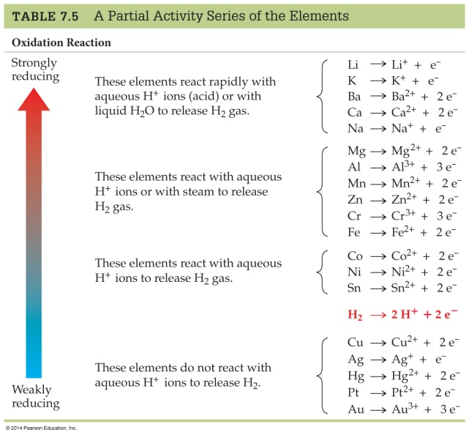
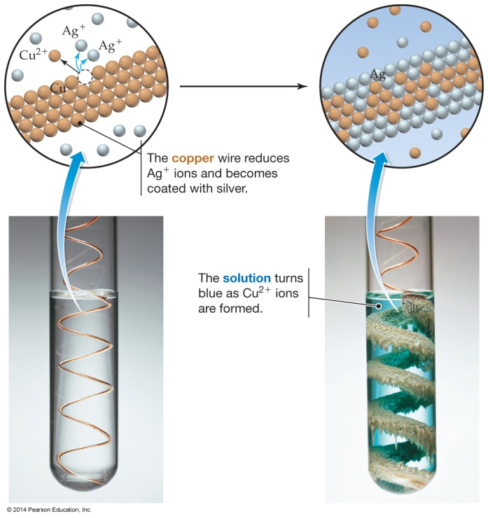
Silver cation will oxidize copper, becoming solid silver, and liberating copper (II) ions. Looking at the diagram to the left, which one of the four reactions below will occur?
a)
b)
c)
d)
e)
Notes:
Answer: a

Slide 9
Silver cation will oxidize copper, becoming solid silver, and liberating copper (II) ions. Looking at the diagram to the left, which one of the four reactions below will occur?
a)
b)
c)
d)
e)
Notes:
Answer: a

Slide 10
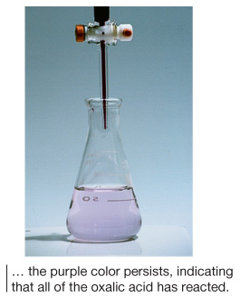
The reaction occurring during the titration of oxalic acid (H₂C₂O₄) with permanganate ion (MnO₄–) is as follows,
In the titration of 0.0117 mol of the oxalic acid primary standard, it was found that
18.5 mL of permanganate solution was required to reach the light purple endpoint. What is the concentration of the permanganate solution?
a) 2.53 × 10^{–4} M
c) 0.253 M
e) 1.58 M
b) 6.32 × 10^{–4} M
d) 0.632 M
Notes:
Answer: c

Slide 11
The reaction occurring during the titration of oxalic acid (H₂C₂O₄) with permanganate ion (MnO₄–) is as follows,
In the titration of 0.0117 mol of the oxalic acid primary standard, it was found that
18.5 mL of permanganate solution was required to reach the light purple endpoint. What is the concentration of the permanganate solution?
a) 2.53 × 10^{–4} M
c) 0.253 M
e) 1.58 M
b) 6.32 × 10^{–4} M
d) 0.632 M
Notes:
Answer: c

Slide 12
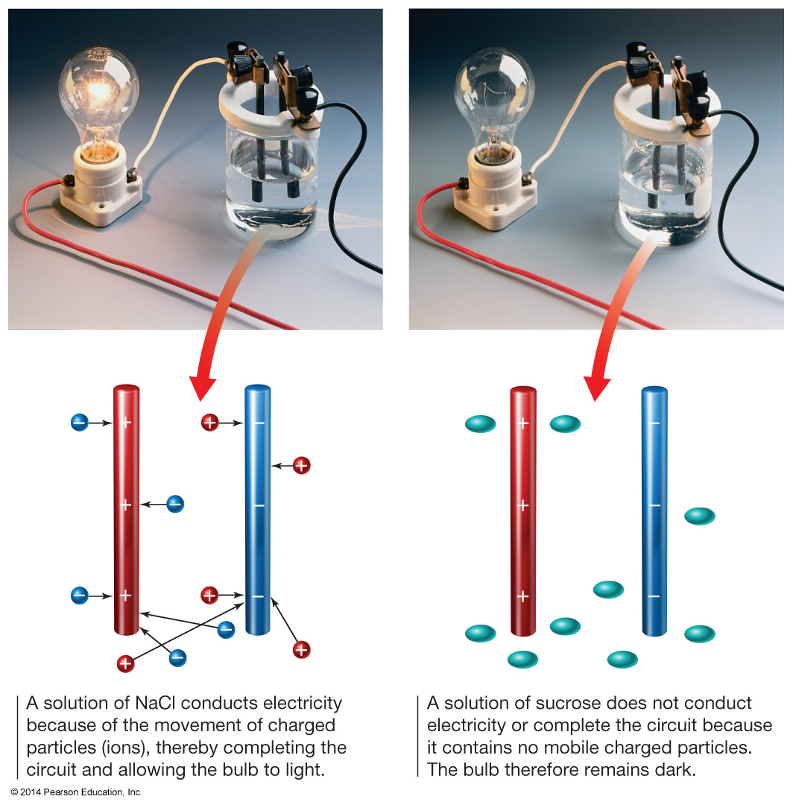
Which of the following would you expect is a
non-electrolyte and would not conduct electricity at all?
a) HCl
d) HF
b) H₂O
e) H₂SO₄
c) KBr
Notes:
Answer: b

Slide 13
Which of the following would you expect is a
non-electrolyte and would not conduct electricity at all?
a) HCl
d) HF
b) H₂O
e) H₂SO₄
c) KBr
Notes:
Answer: b

Slide 14
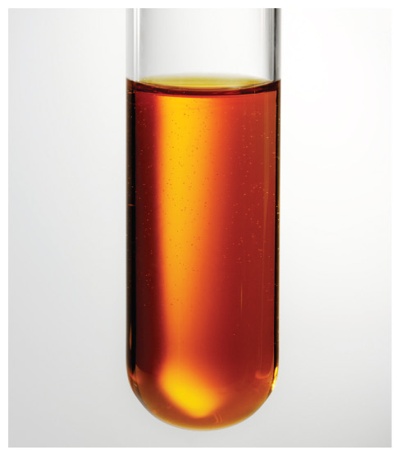
Na₂Cr₂O₇ is a strong electrolyte which dissociates to sodium ions and dichromate dianion. What is the total ion concentration in a 0.450 M solution of Na₂Cr₂O₇?
a) 0.150
d) 0.900
b) 0.225
e) 1.35
c) 0.450
Notes:
Answer: e

Slide 15
Na₂Cr₂O₇ is a strong electrolyte which dissociates to sodium ions and dichromate dianion. What is the total ion concentration in a 0.450 M solution of Na₂Cr₂O₇?
a) 0.150
d) 0.900
b) 0.225
e) 1.35
c) 0.450
Notes:
Answer: e

Slide 16
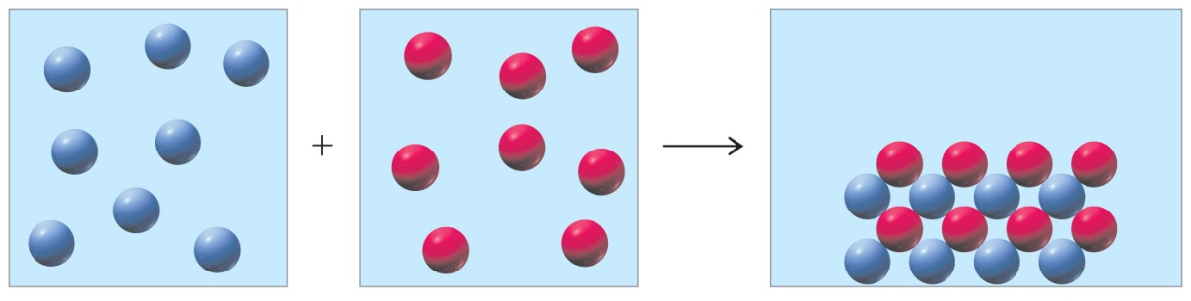
What substance will precipitate out of solution?
Co²⁺
CH₃COO–
K⁺
?
Cl–
NO₃–
Ag⁺
Na⁺
OH–
a) CaCl₂ and Co(OH)₂
b) AgCl, AgOH, and Co(OH)₂
c) AgCl, AgOH, and CH₃COOAg
d) AgCl, CH₃COOAg, and CH₃COOK
e) No precipitate forms.
Notes:
Answer: b

Slide 17
What substance will precipitate out of solution?
Co²⁺
CH₃COO–
K⁺
?
Cl–
NO₃–
Ag⁺
Na⁺
OH–
a) CaCl₂ and Co(OH)₂
b) AgCl, AgOH, and Co(OH)₂
c) AgCl, AgOH, and CH₃COOAg
d) AgCl, CH₃COOAg, and CH₃COOK
e) No precipitate forms.
Notes:
Answer: b

Slide 18
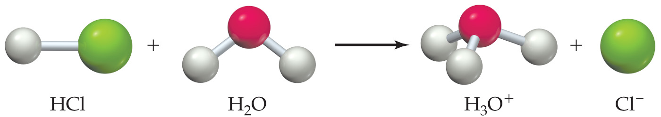
In the redox reaction indicated above, which is the oxidizing agent?
a) MnO₄–
b) Fe²⁺
c) H⁺
d) H₂O
e) None of the above
Notes:
Answer: a

Slide 19
In the redox reaction indicated above, which is the oxidizing agent?
a) MnO₄–
b) Fe²⁺
c) H⁺
d) H₂O
e) None of the above
Notes:
Answer: a

Slide 20
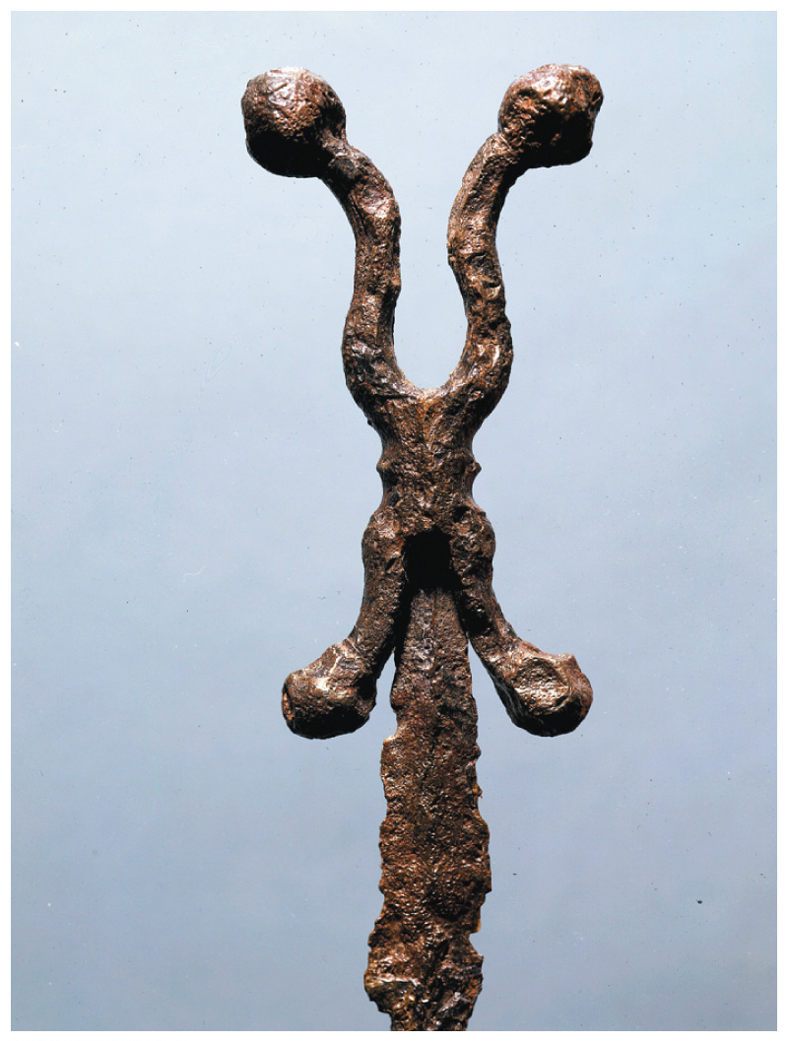
Iron rust has the molecular formula Fe₂O₃.
What is the oxidation state of Fe in rust?
a) 0
d) 3
b) 1
e) 4
c) 2
Notes:
Answer: d

Slide 21
Iron rust has the molecular formula Fe₂O₃.
What is the oxidation state of Fe in rust?
a) 0
d) 3
b) 1
e) 4
c) 2
Notes:
Answer: d

Slide 22
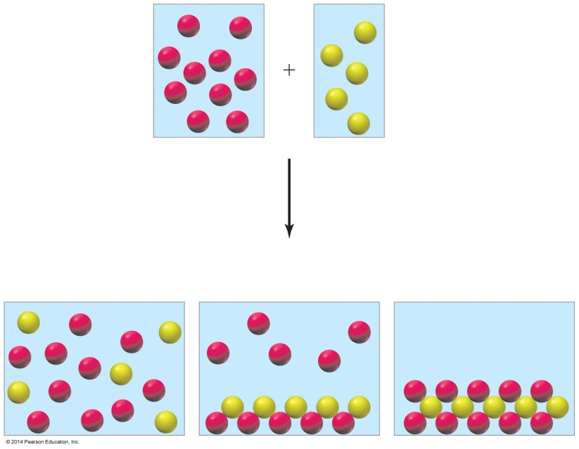

Which of the following is the best pictorial representation of what would happen if a solution containing silver cations were mixed with one containing nitrate anions?
a)
b)
c)
Notes:
Answer: a

Slide 23
Which of the following is the best pictorial representation of what would happen if a solution containing silver cations were mixed with one containing nitrate anions?
a)
b)
c)
Notes:
Answer: a

Slide 24
The reaction,
Na₃PO₄(aq) + 3 AgNO₃(aq) → Ag₃PO₄(s) + 3 NaNO₃(aq)
is best classified as a(n)
a) acid–base neutralization reaction.
b) oxidation–reduction reaction.
c) precipitation reaction (double replacement).
d) single replacement reaction.
e) None of the above
Notes:
Answer: c

Slide 25
The reaction,
Na₃PO₄(aq) + 3 AgNO₃(aq) → Ag₃PO₄(s) + 3 NaNO₃(aq)
is best classified as a(n)
a) acid–base neutralization reaction.
b) oxidation–reduction reaction.
c) precipitation reaction (double replacement).
d) single replacement reaction.
e) None of the above
Notes:
Answer: c

Slide 26
The reaction,
NaHCO₃(aq) + HNO₃(aq) → H₂O(l) + CO₂ (g) + NaNO₃(aq)
is best classified as a(n)
a) acid–base neutralization reaction.
b) oxidation–reduction reaction.
c) precipitation reaction (double replacement).
d) single replacement reaction.
e) None of the above
Notes:
Answer: a

Slide 27
The reaction,
NaHCO₃(aq) + HNO₃(aq) → H₂O(l) + CO₂ (g) + NaNO₃(aq)
is best classified as a(n)
a) acid–base neutralization reaction.
b) oxidation–reduction reaction.
c) precipitation reaction (double replacement).
d) single replacement reaction.
e) None of the above
Notes:
Answer: a

Slide 28
The reaction,
Mg+ 2HNO₃(aq) → H₂(g) + Mg(NO₃)₂(aq)
is best classified as a(n)
a) acid–base neutralization reaction.
b) oxidation–reduction reaction.
c) precipitation reaction (double replacement).
d) single replacement reaction.
e) b and d
Notes:
Answer: e

Slide 29
The reaction,
Mg+ 2HNO₃(aq) → H₂(g) + Mg(NO₃)₂(aq)
is best classified as a(n)
a) acid–base neutralization reaction.
b) oxidation–reduction reaction.
c) precipitation reaction (double replacement).
d) single replacement reaction.
e) b and d
Notes:
Answer: e

Slide 30
ClO–(aq) + Cr(OH)₄–(aq) → CrO₄^{2–}(aq) + Cl–(aq)
What is the reduction half reaction for the above chemical reaction in a basic solution?
a) ClO–(aq) + 2 H⁺(aq) + 2e– → Cl–(aq) + H₂O(l)
b) ClO–(aq) + H₂O(l) + 2e– → Cl–(aq) + 2 OH–(aq)
c) Cr(OH)₄–(aq) + 4 OH–(aq) → CrO₄^{2–}(aq) + 4 H₂O(l) + 3e–
d) Cr(OH)₄–(aq) → CrO₄^{2–}(aq) + 4 H⁺(aq) + 3e–
e) None of the above
Notes:
Answer: b

Slide 31
ClO–(aq) + Cr(OH)₄–(aq) → CrO₄^{2–}(aq) + Cl–(aq)
What is the reduction half reaction for the above chemical reaction in a basic solution?
a) ClO–(aq) + 2 H⁺(aq) + 2e– → Cl–(aq) + H₂O(l)
b) ClO–(aq) + H₂O(l) + 2e– → Cl–(aq) + 2 OH–(aq)
c) Cr(OH)₄–(aq) + 4 OH–(aq) → CrO₄^{2–}(aq) + 4 H₂O(l) + 3e–
d) Cr(OH)₄–(aq) → CrO₄^{2–}(aq) + 4 H⁺(aq) + 3e–
e) None of the above
Notes:
Answer: b

Slide 32
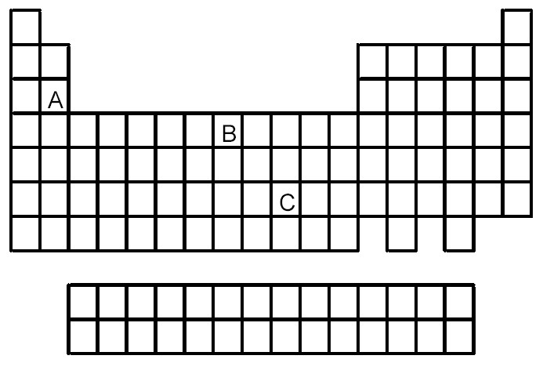
Based on the positions in the periodic table of elements A, B, and C, which of the following reactions would you expect to occur?
a) A²⁺ + B → A + B²⁺
b) B²⁺ + C → B + C²⁺
c) C²⁺ + A → C + A²⁺
d) None of the reactions would be expected to occur.
e) All of the reactions would be expected to occur.
Notes:
Answer: c

Slide 33
Based on the positions in the periodic table of elements A, B, and C, which of the following reactions would you expect to occur?
a) A²⁺ + B → A + B²⁺
b) B²⁺ + C → B + C²⁺
c) C²⁺ + A → C + A²⁺
d) None of the reactions would be expected to occur.
e) All of the reactions would be expected to occur.
Notes:
Answer: c

